Slide 1
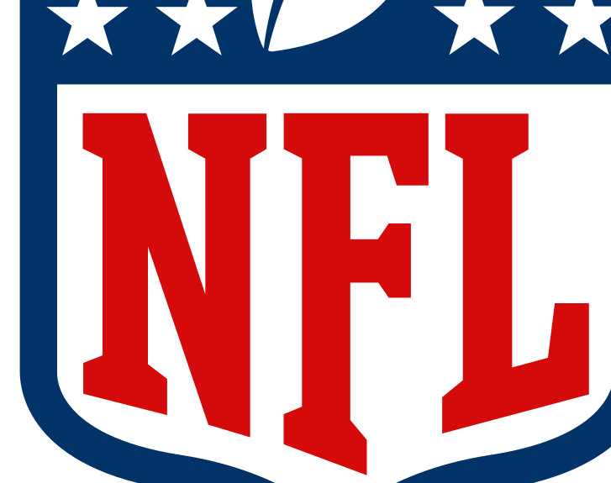
Using Text Mining to Build the Ultimate Fantasy Football Team
Brian Taylor
Lindsay Kotouch
Craig Beach

Slide 2
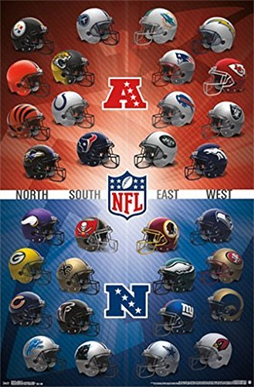
Agenda
Why Fantasy Football
Process Pivot
Shape of Data
Does Sentiment matter?
Can Twitter Predict Winners?
Lessons Learned
Future Opportunities in Research

Slide 3
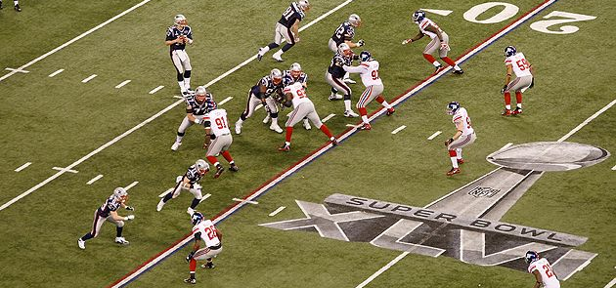

Why Fantasy Football?

Slide 4
Process Pivot
Initial question: can we predict fantasy performance outcomes based on Twitter sentiment from the week before?
A roadblock, & a pivot
Later exploration: can we predict the player, their position, or their season performance based on Twitter sentiment?

Slide 5
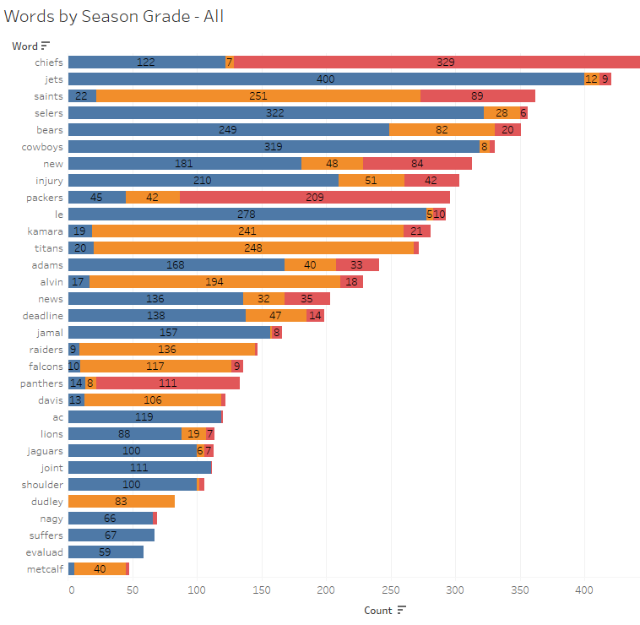

Breakdown Bag of Words

Slide 6
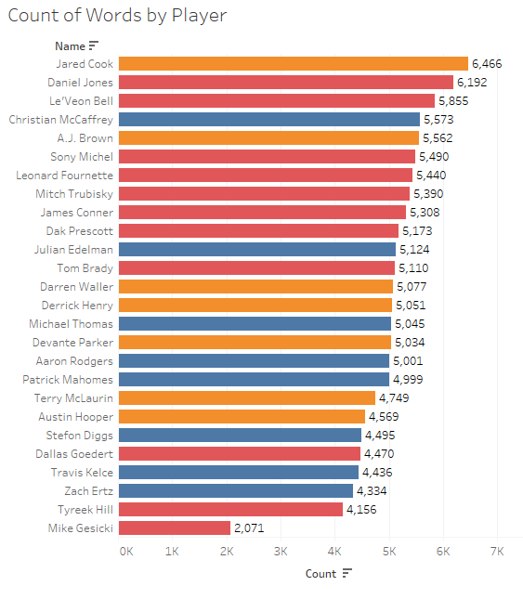

Which players are talked to about the most on Twitter?

Slide 7
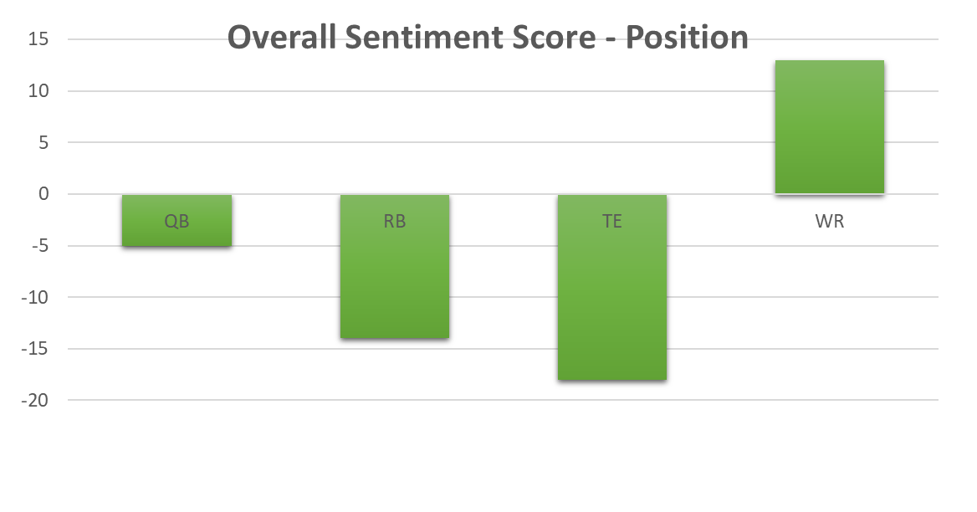
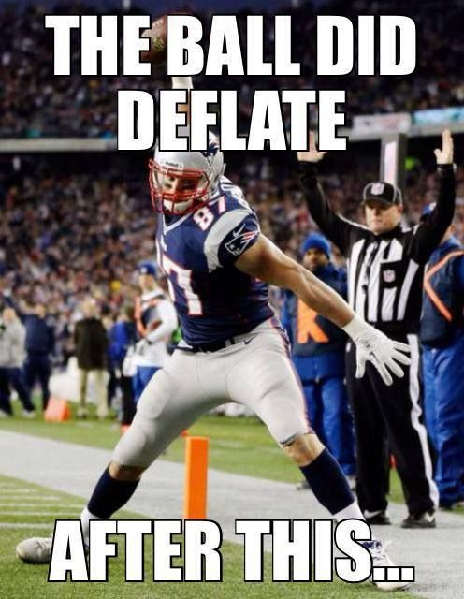
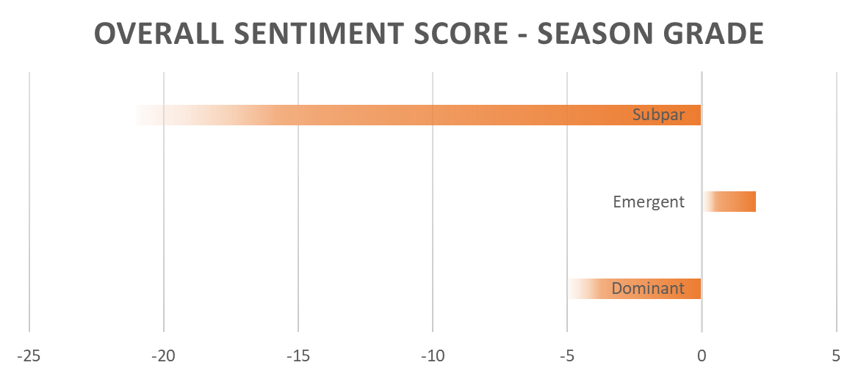
Position/Grade | Sum of Total Score
QB | -5
Dominant | 1
Subpar | -6
RB | -14
Dominant | 3
Emergent | 1
Subpar | -18
TE | -18
Dominant | -13
Emergent | -5
Subpar | 0
WR | 13
Dominant | 4
Emergent | 6
Subpar | 3

Slide 8
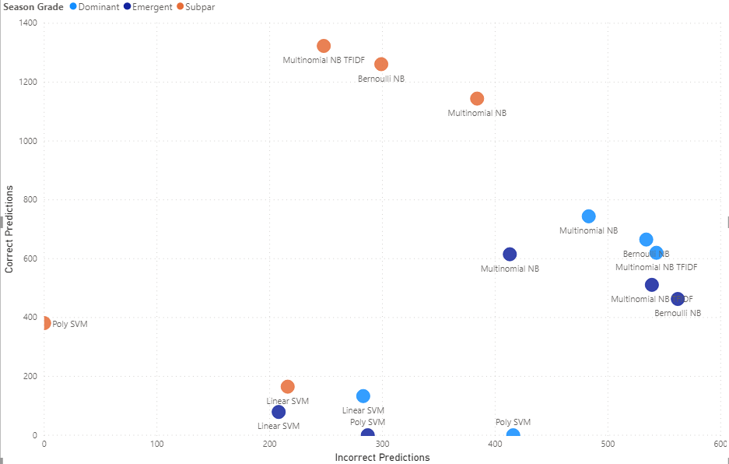
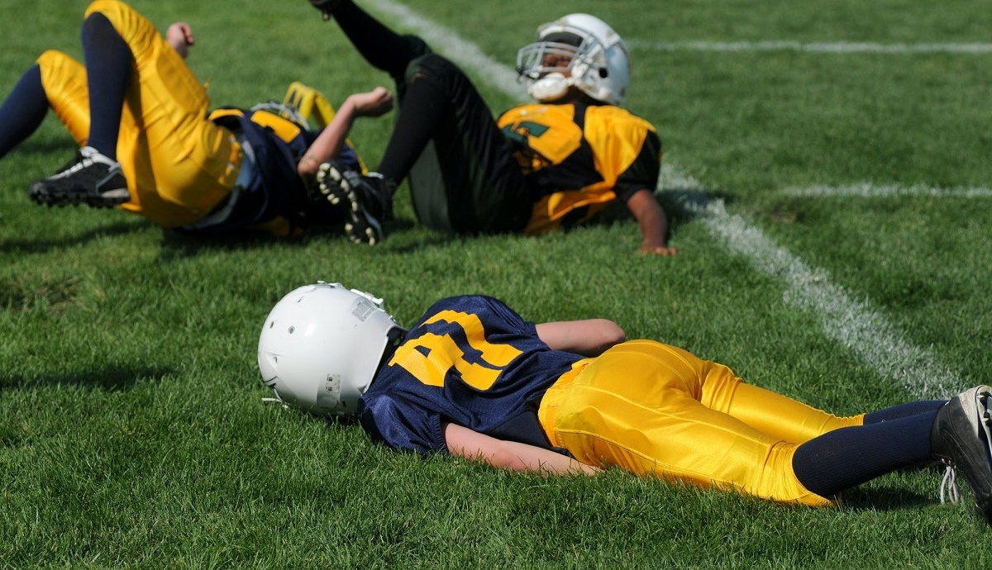
Can the Models Predict a Players Success or…..

Slide 9
Important Words
Week
NFL
Team names
Yards
TD’s
Fantasy
Best

Slide 10

Lessons Learned
Use other sources of data
Football has its own language
Negative words mean positive things
Sick, Raw, Dominate, Blitz
Analogies
“Tom Brady is the Michael Jordan of Football”
“Patrick Mahomes passes are like Lionel Messi’s”
Domain specific
MVP, OPOY, DPOY
Slang
You got mossed!
He took it to the house!

Slide 11
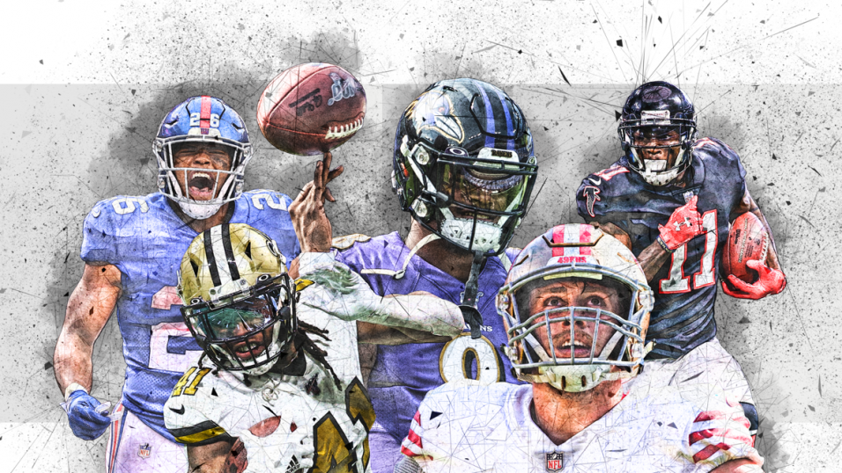
Future Opportunities
Week by Week breakdown – Fantasy Score vs. Text
More specific sentiment analyzer
Try other sources of text data

Slide 12


